Slide 1
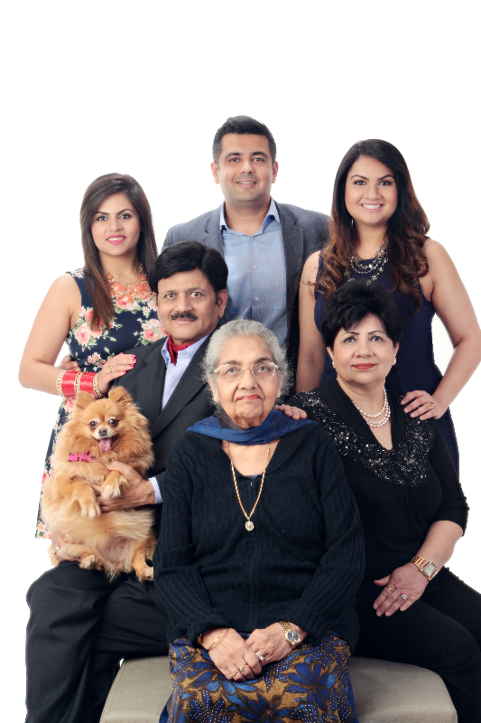
Profile-Bhushan Sood
My Family
Mom in law
Shiny-Ashish
Shwinky
Pixy
Me and Jyoti

Slide 2
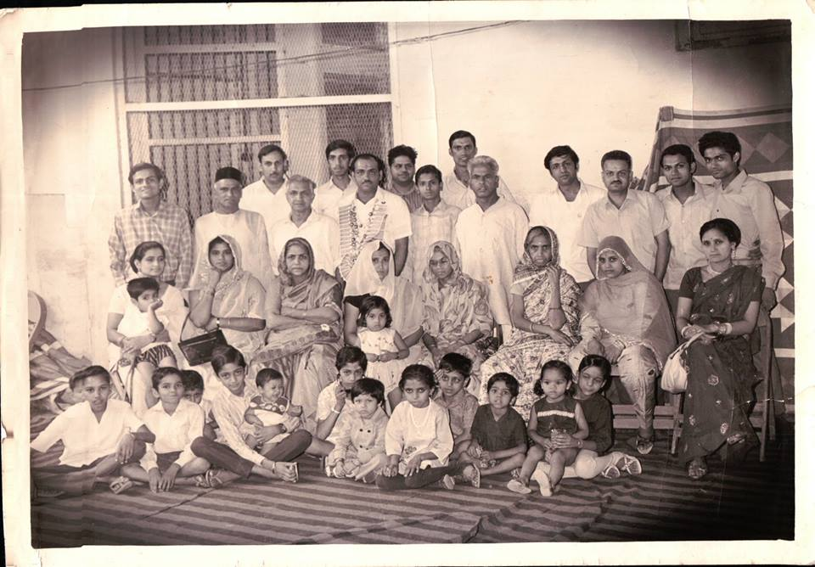
Profile-Bhushan Sood
My extended Family

Slide 3
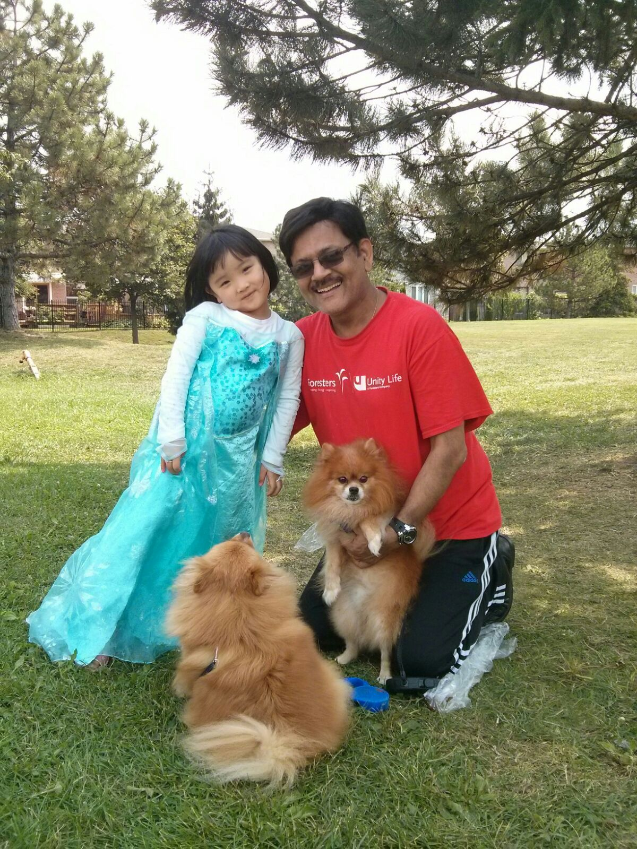
Profile-Bhushan Sood
My Passion for Babies and Pets

Slide 4
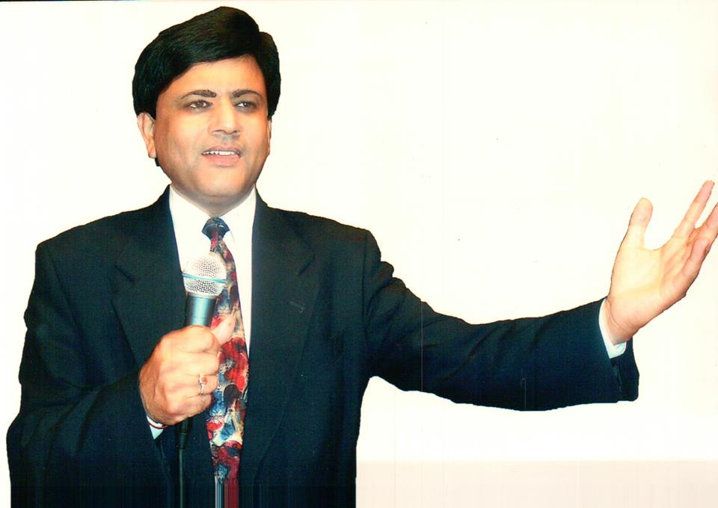
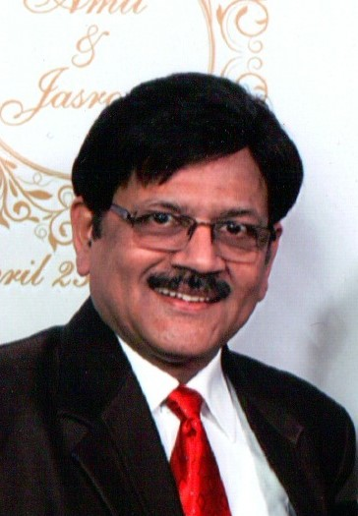
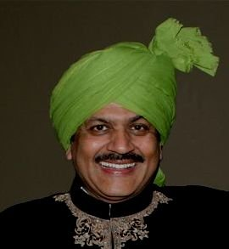
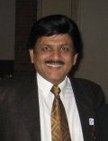
Profile-Bhushan Sood
Me

Slide 5
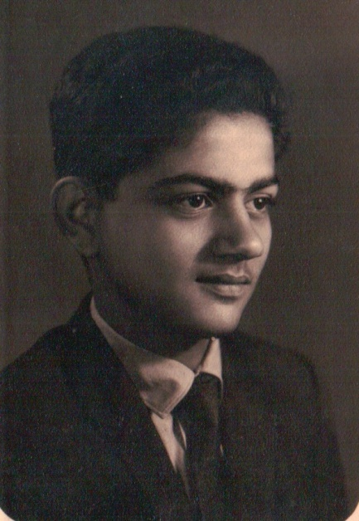
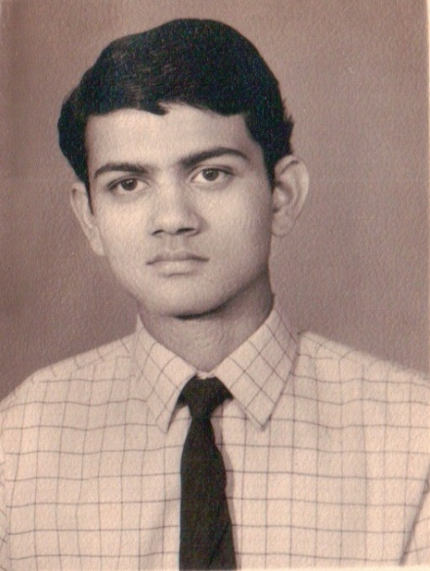
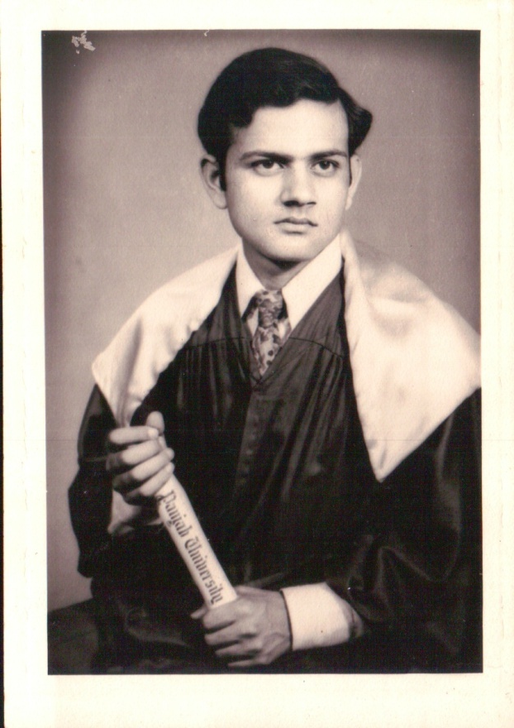
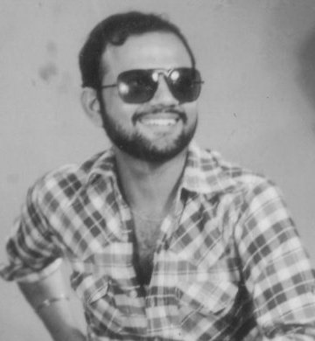
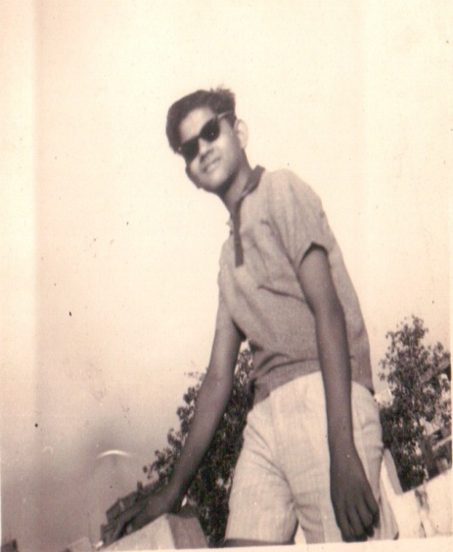
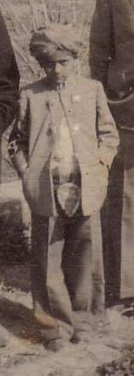
Profile-Bhushan Sood
Upto BSc

Slide 6
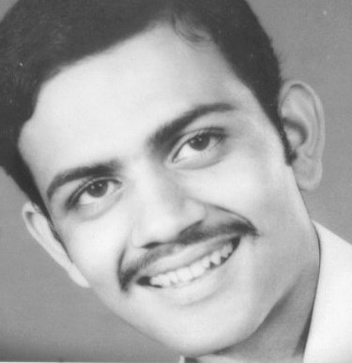
Profile-Bhushan Sood
Higher Secondary time

Slide 7
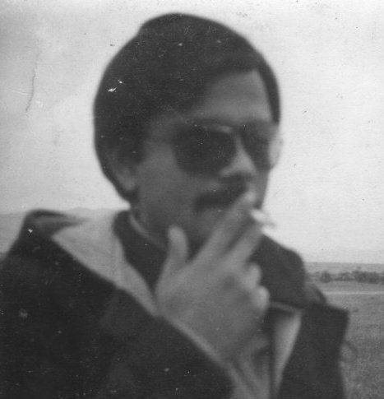
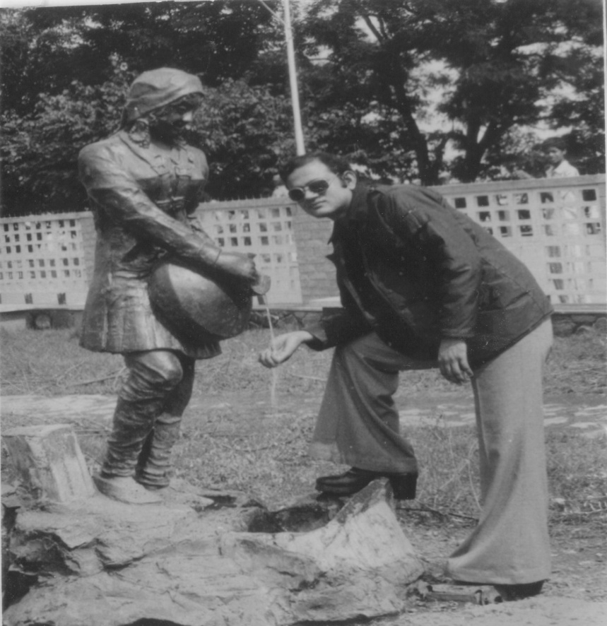
Profile-Bhushan Sood
Fun at Shimla

Slide 8
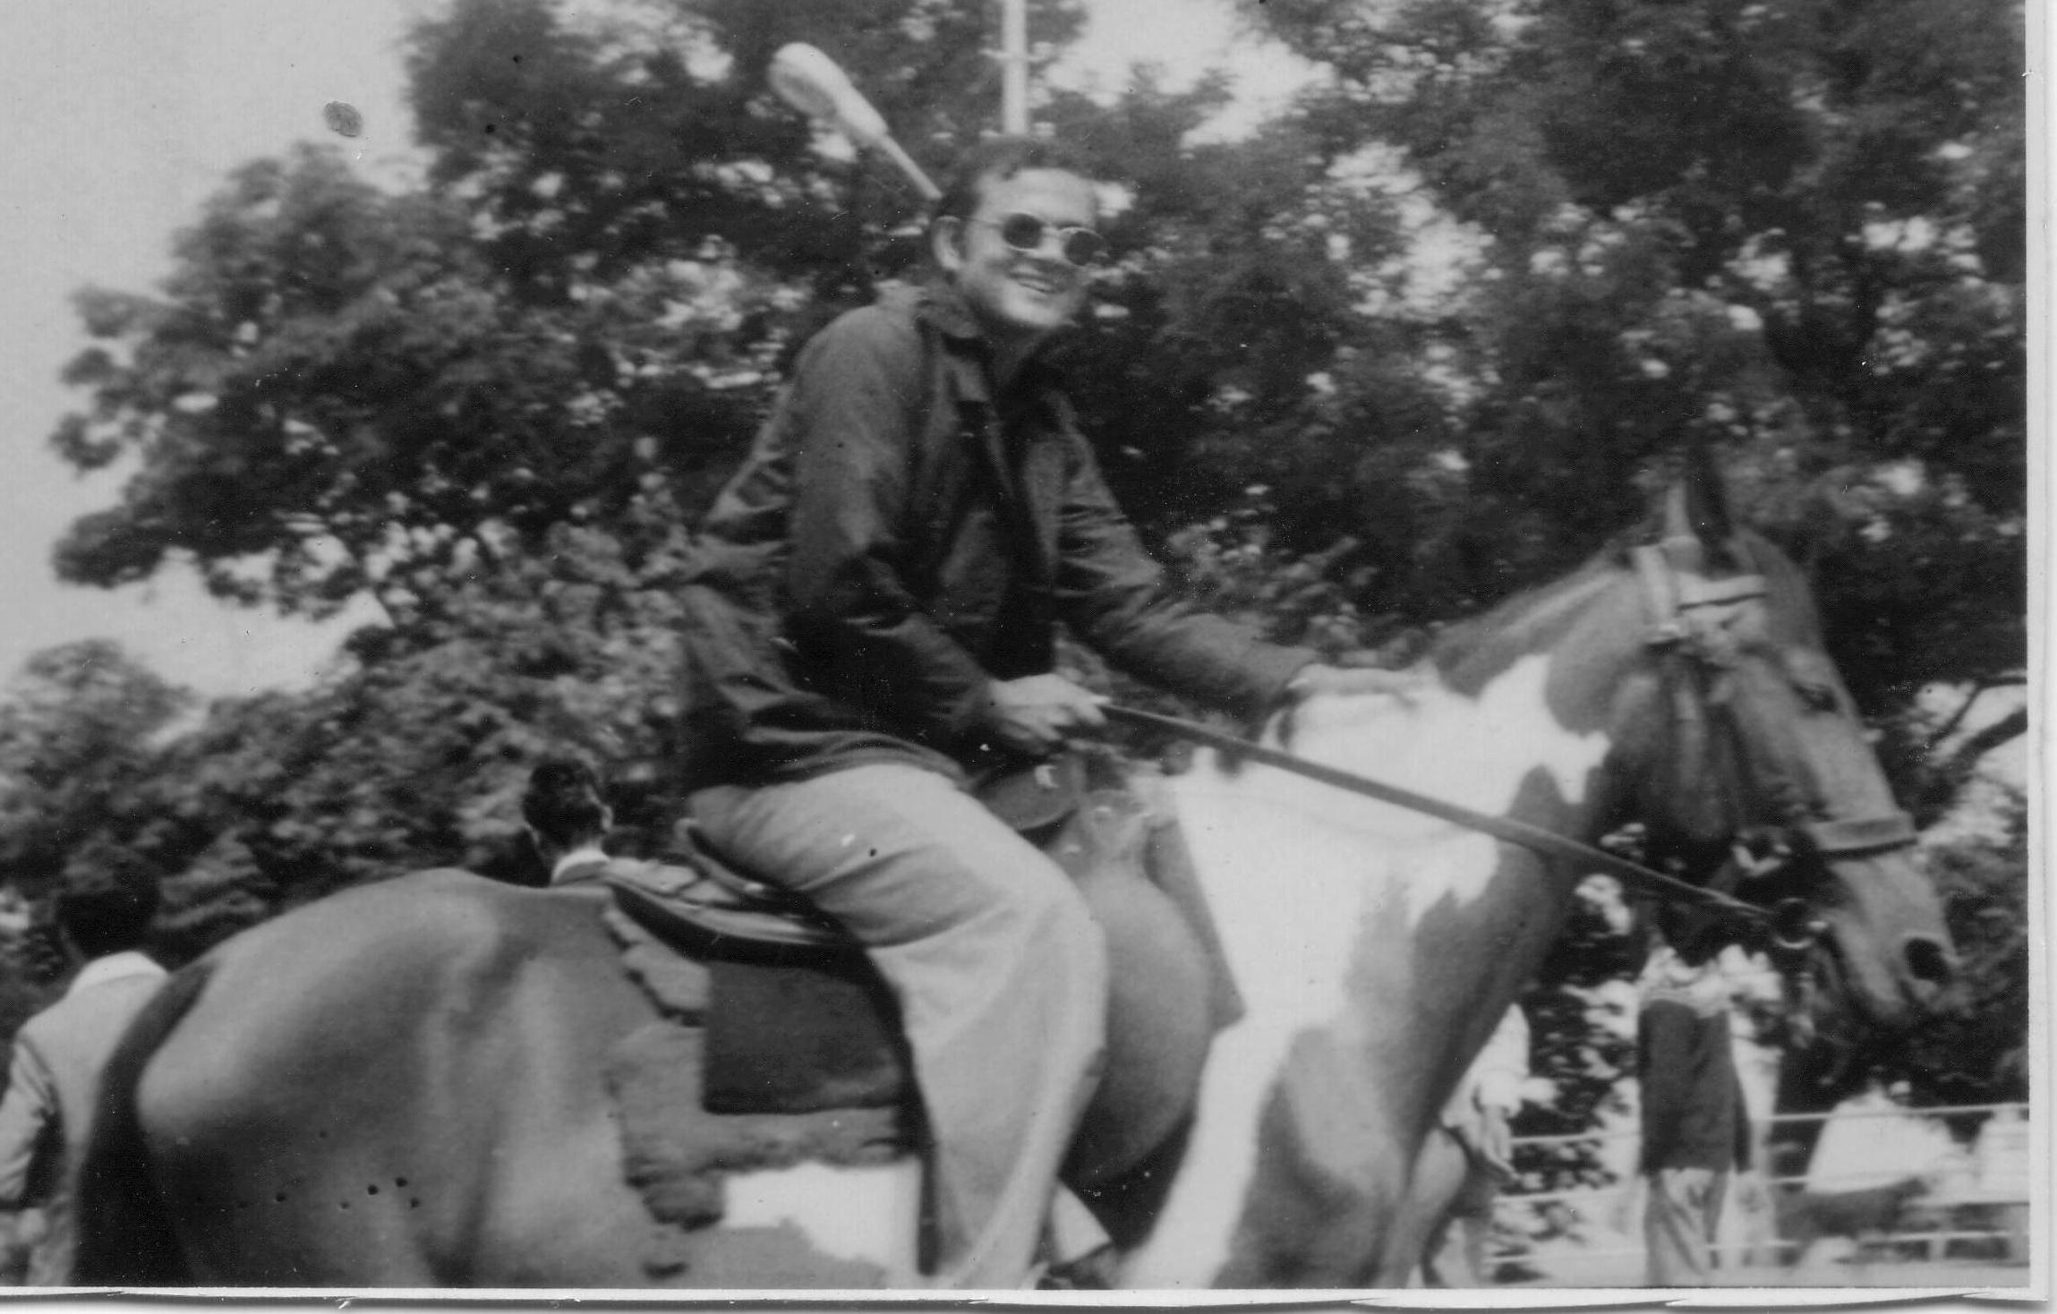
Profile-Bhushan Sood
At The ridge Shimla

Slide 9
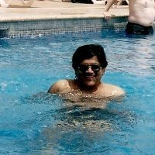
Profile-Bhushan Sood
Ponta Cana – Dominic Republic

Slide 10
Profile-Bhushan Sood
My School Teachers
@
SD Higher Secondary School

Slide 11
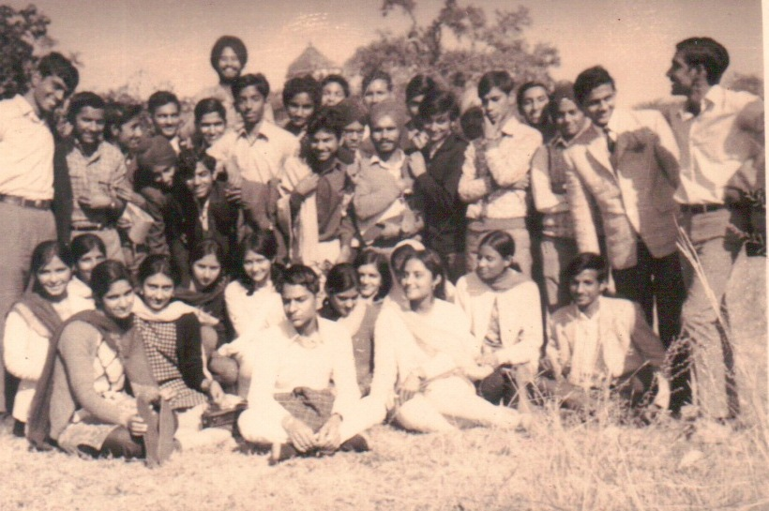
Profile-Bhushan Sood
My 1971 Batch – B.Sc.

Slide 12
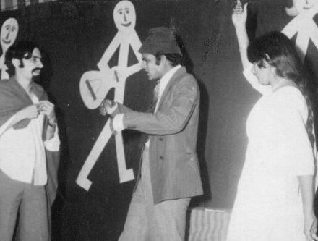
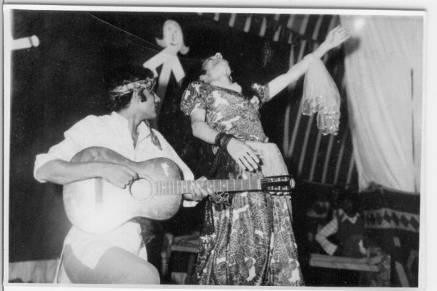
Profile-Bhushan Sood
Play Zameela
Song from Sholay
Mehbuba o Mehbuba

Slide 13
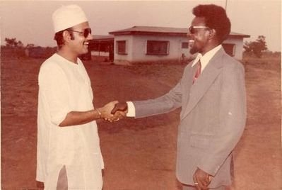
Profile-Bhushan Sood
My best friend in Nigeria- Haruna

Slide 14
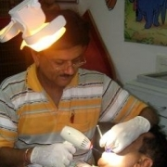
Profile-Bhushan Sood
Clinical Dentistry

Slide 15
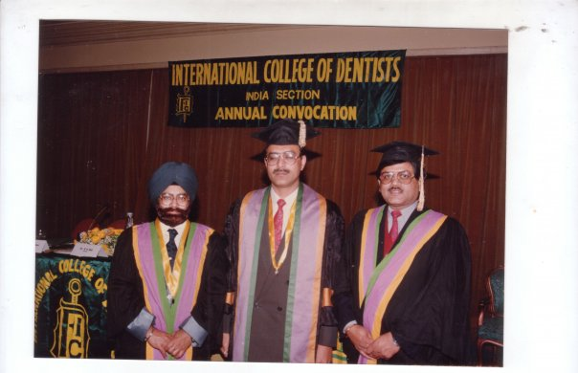
Profile-Bhushan Sood
Awarded Fellowship International College of Dentists

Slide 16
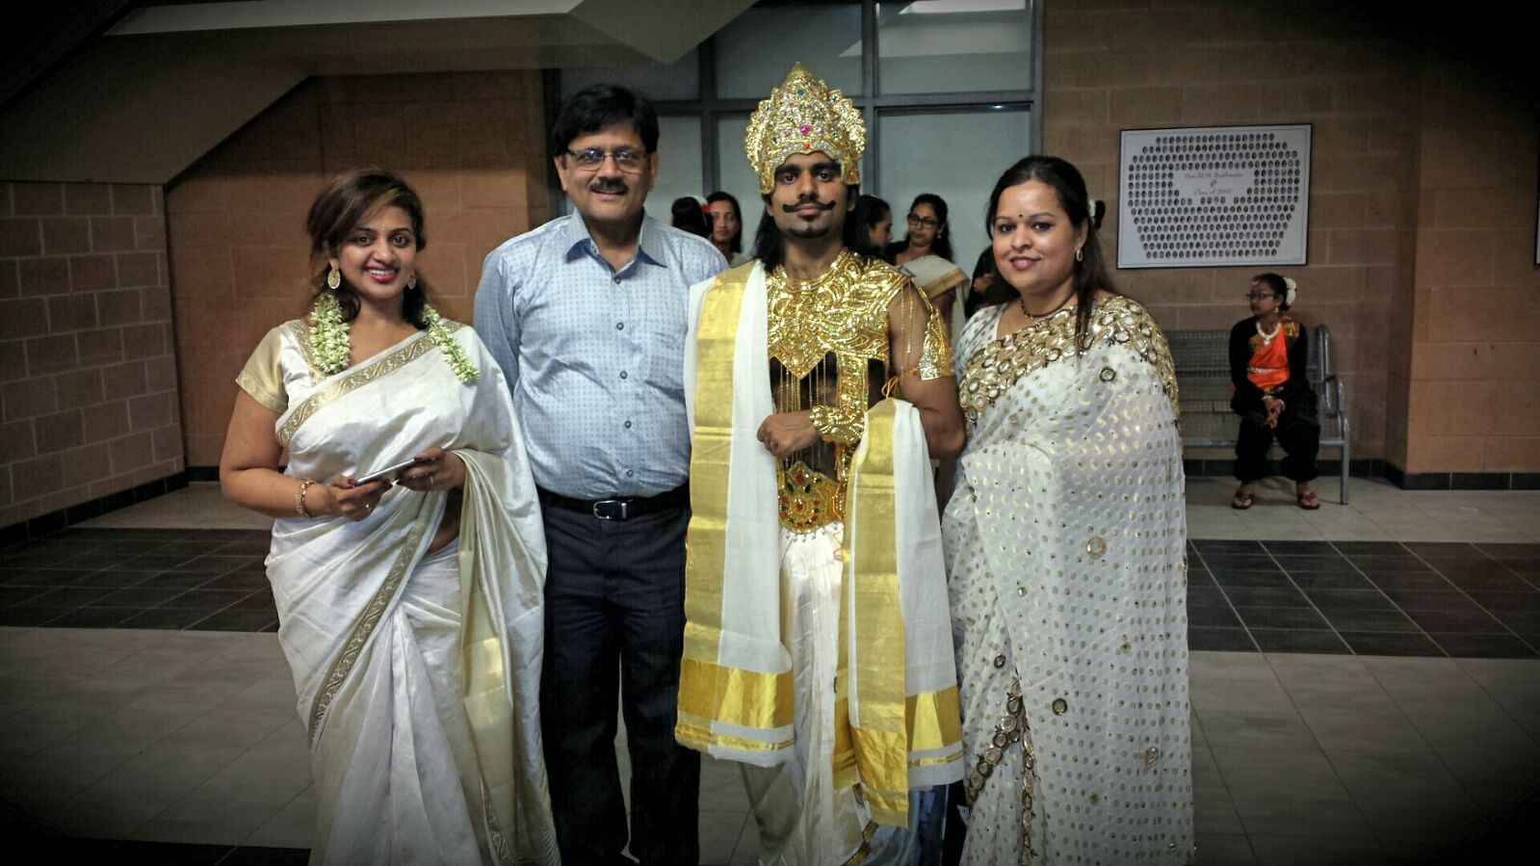
Profile-Bhushan Sood
Onaam festival - With Mahabali

Slide 17
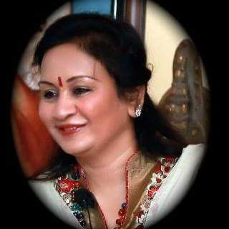
Profile-Bhushan Sood
Spirituality Begins
My first mentor in spirituality.
Revered Sangeeta Amrit Mittal

Slide 18
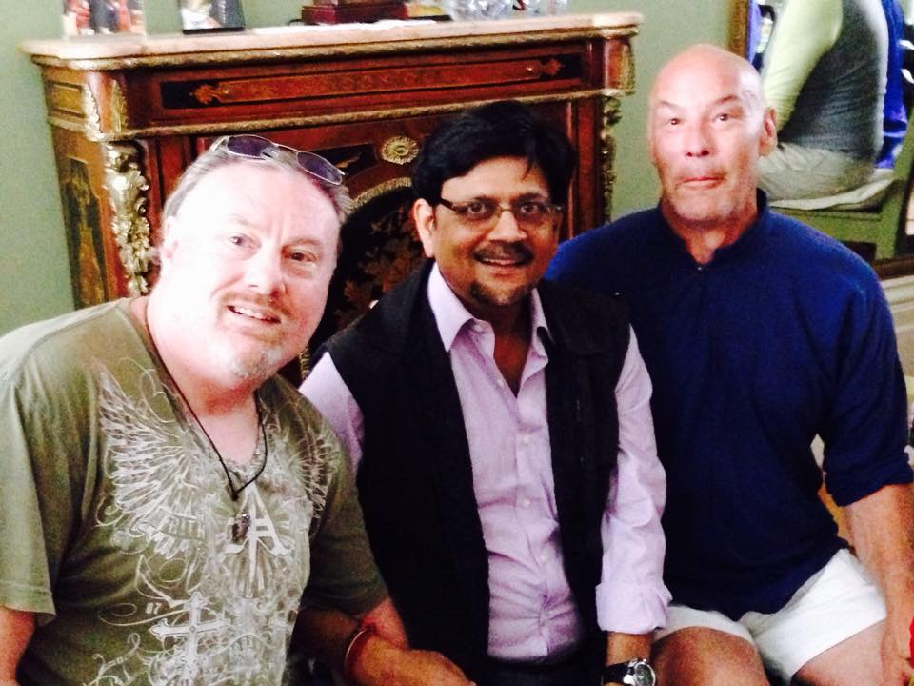
Profile-Bhushan Sood
With Masters Energy healers

Slide 19
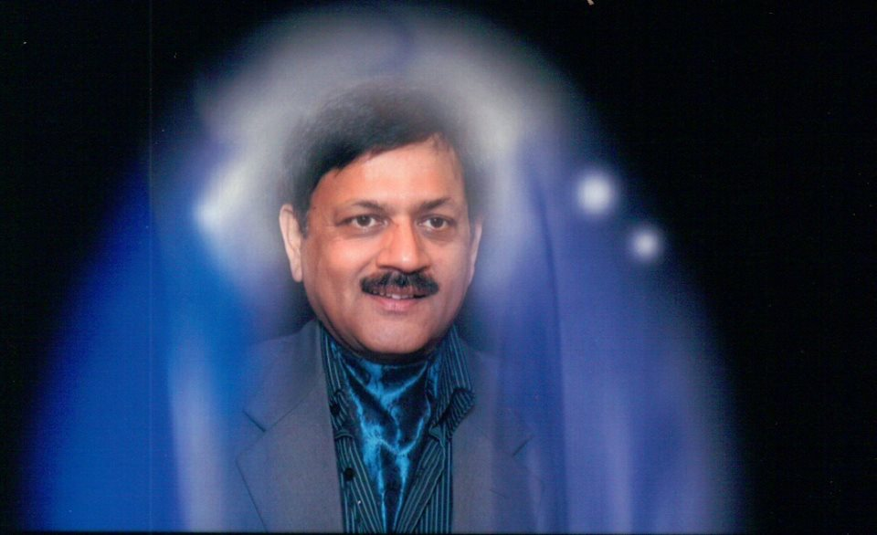
Profile-Bhushan Sood
My Aura-Purple Indigo
Spirits seen on the right

Slide 20
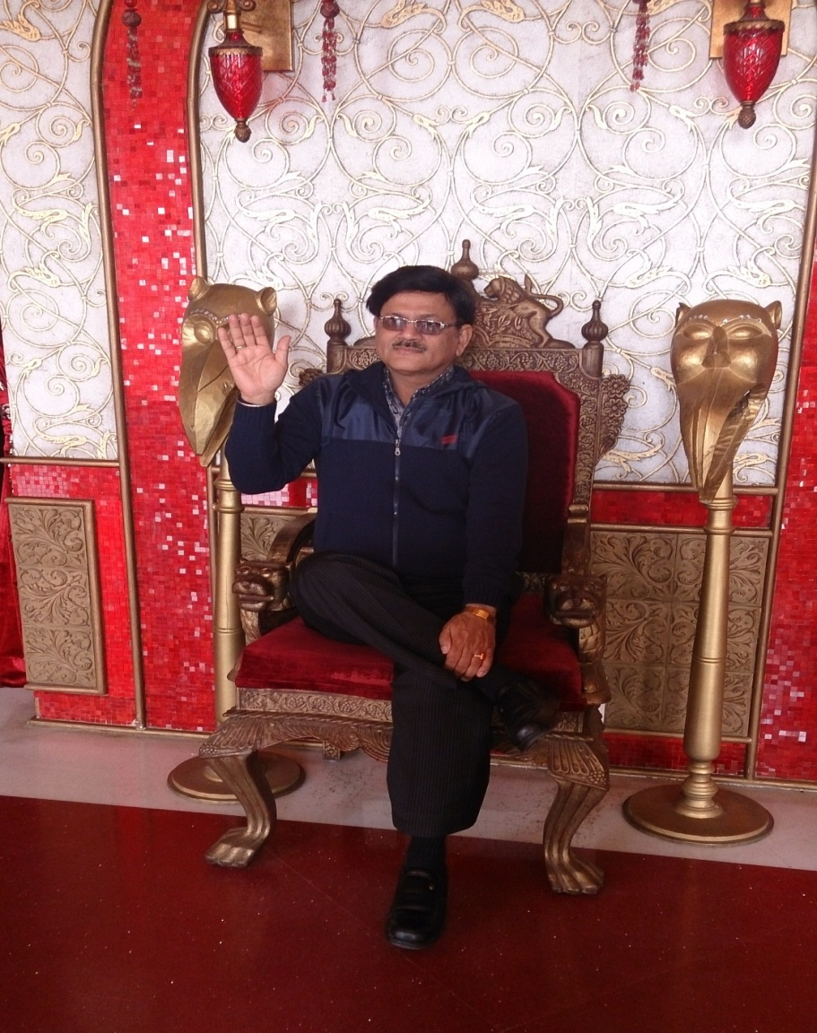
Profile-Bhushan Sood
Healing thru Blessings

Slide 21
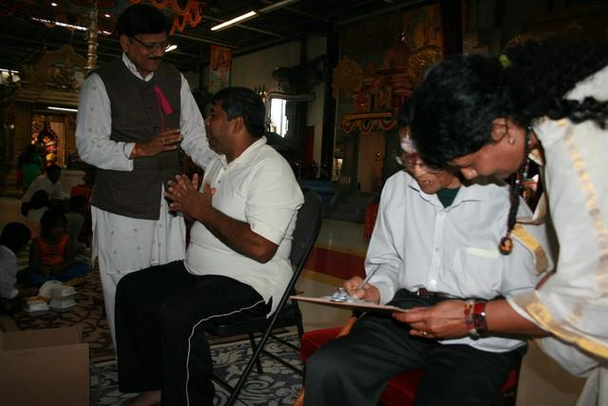
Profile-Bhushan Sood
Giving Spiritual Healing

Slide 22
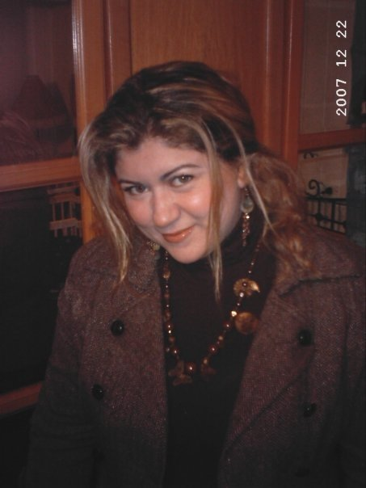
Profile-Bhushan Sood
Soul Connection – through FB – Energy Travel

Slide 23
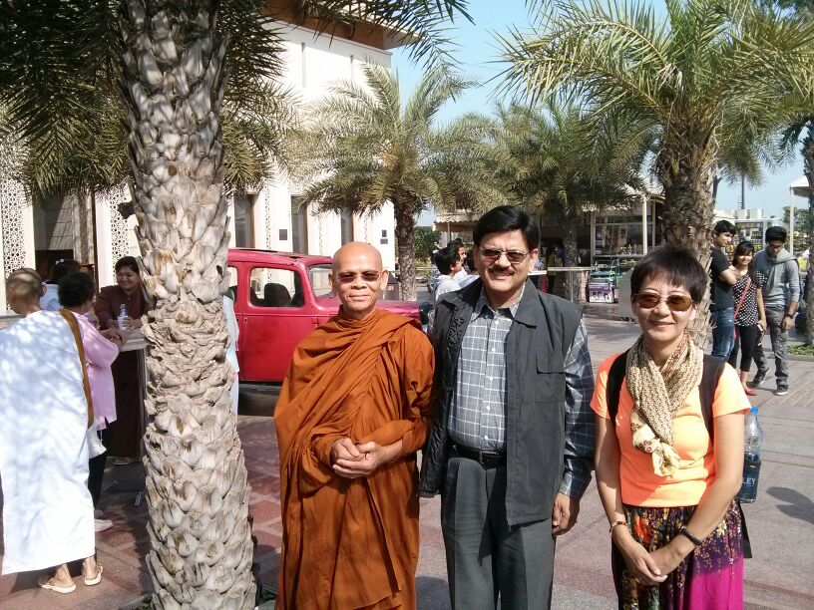
Profile-Bhushan Sood
With Master Buddhist Monk from Thailand

Slide 24
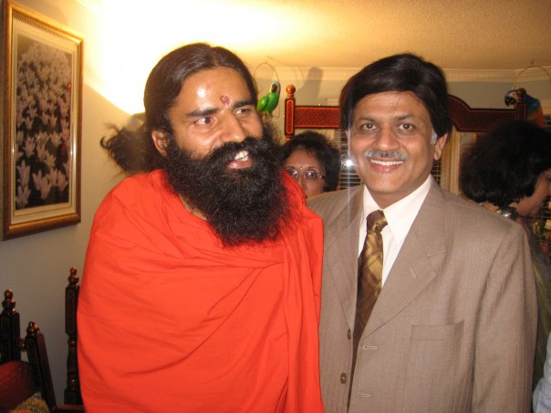
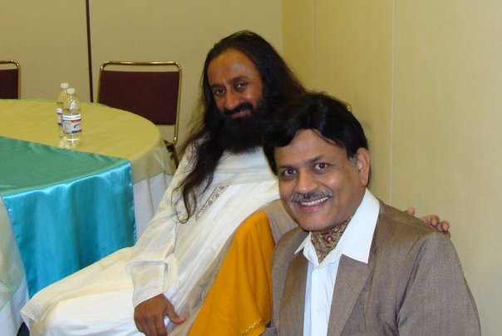
Profile-Bhushan Sood
With Baba RamDev & Sri Sri Ravi Shankara

Slide 25
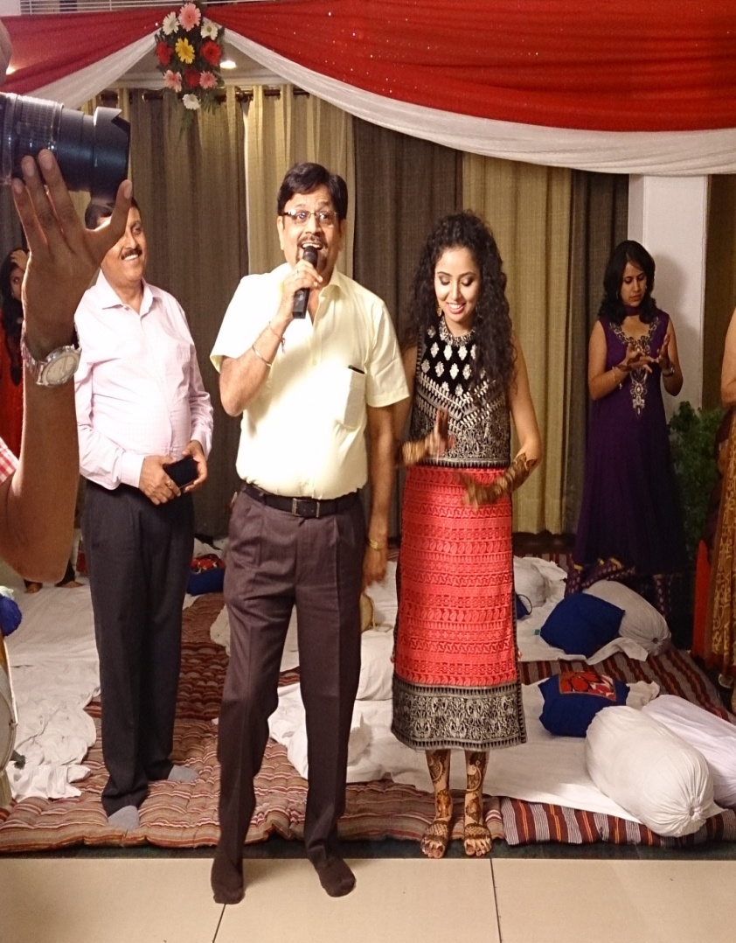
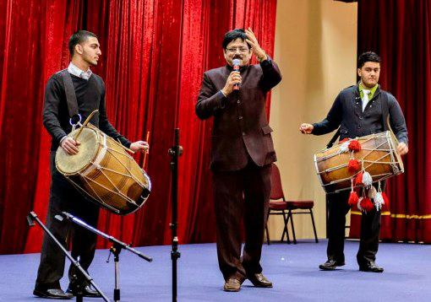
Profile-Bhushan Sood
Singing Folk Songs

Slide 26
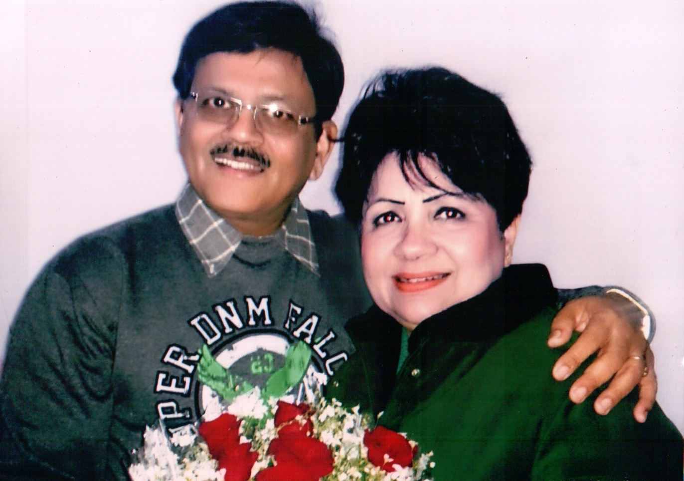
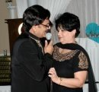
Profile-Bhushan Sood
Going Good

Slide 27
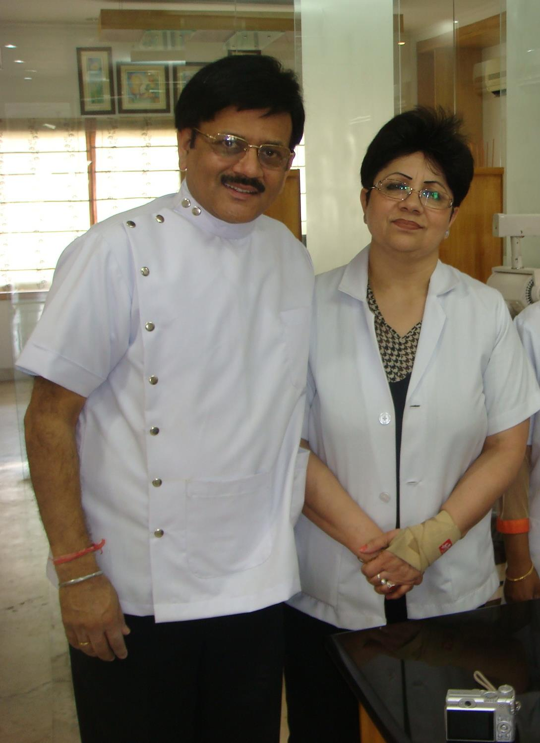
Profile-Bhushan Sood
With my wife, Jyoti
Doing Clinical Products trials for P&G

Slide 28
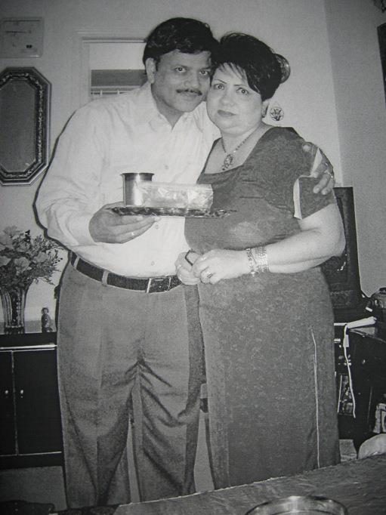
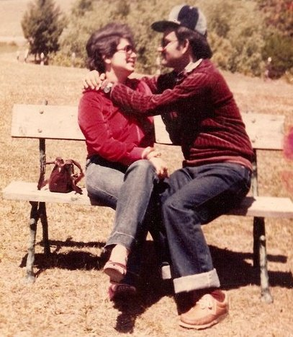
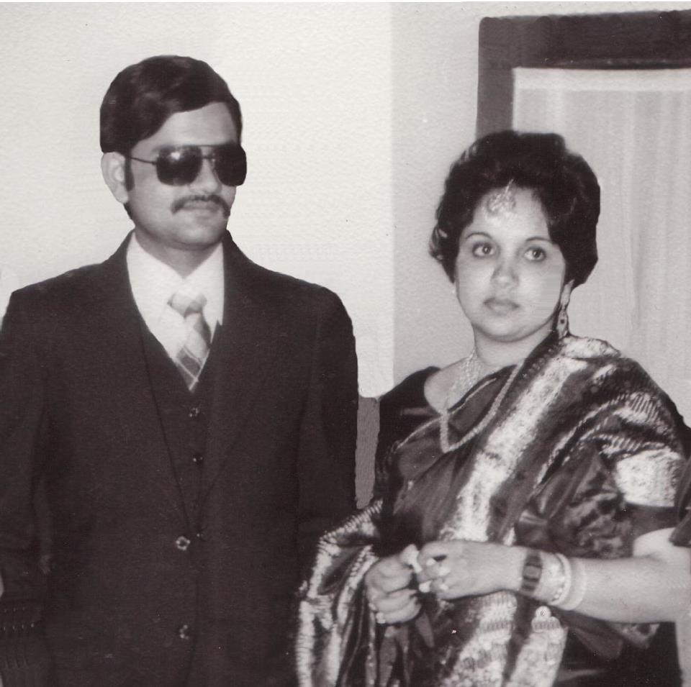
Profile-Bhushan Sood
36 years of togetherness

Slide 29
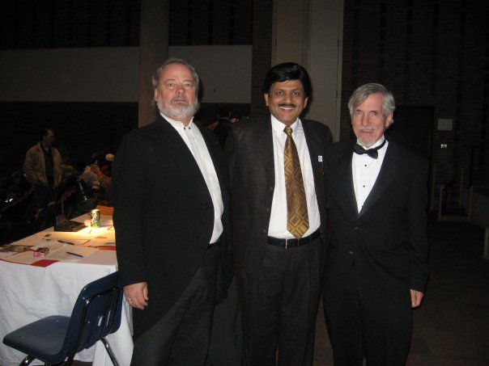
Profile-Bhushan Sood
With Professors of Laurentian University

Slide 30
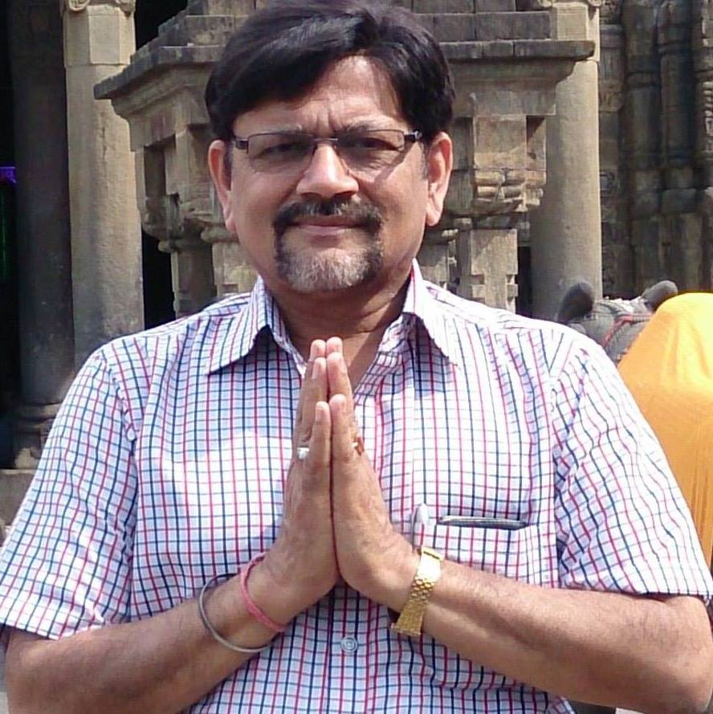
Profile-Bhushan Sood
ॐ पूर्णमदः पूर्णमिदम् पूर्णात् पूर्णमुदच्यते |
पूर्णस्य पूर्णमादाय पूर्णमेवावशिष्यते ||
ॐ शान्तिः शान्तिः शान्तिः ||

